Slide 1

Org Chart Queretaro Plant
Staff_QRO_Team

Slide 2
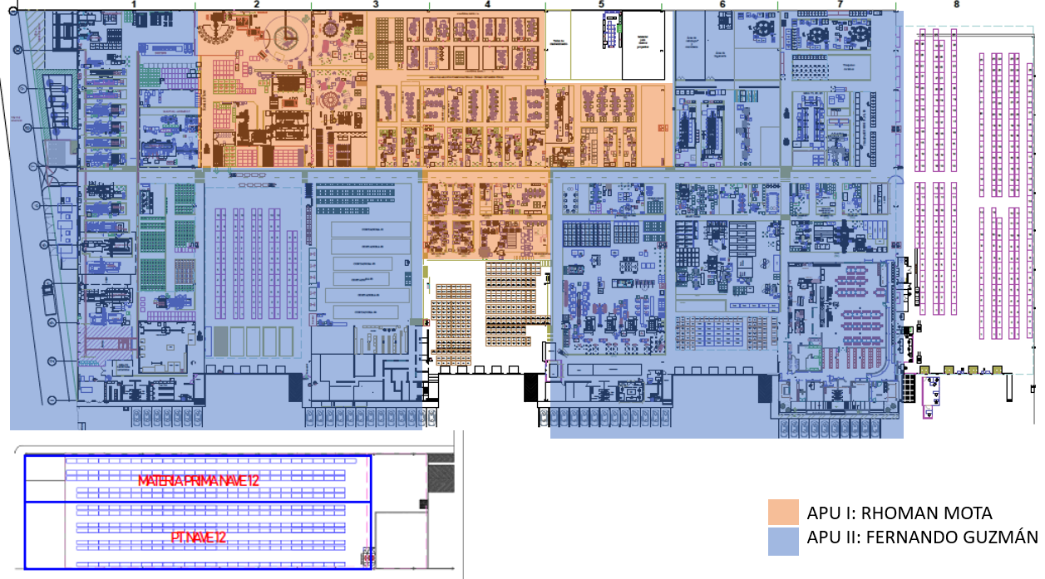
Plant development 2025 – 2 Business Units

Slide 3

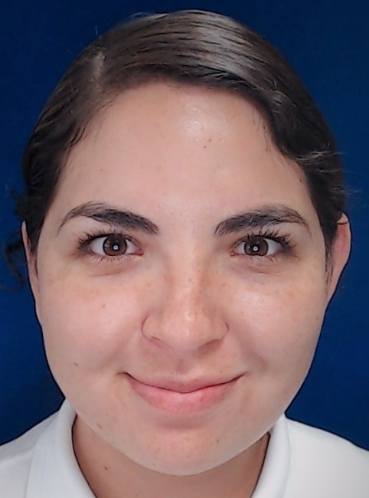
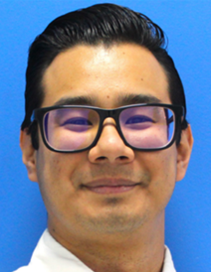
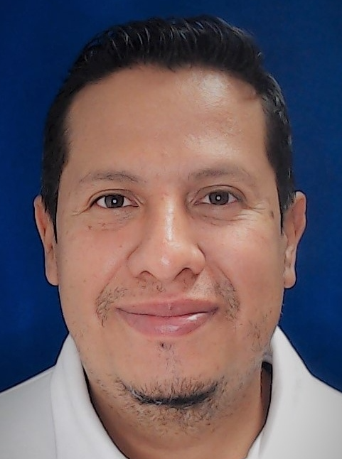
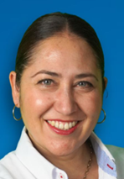
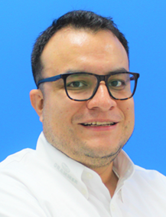
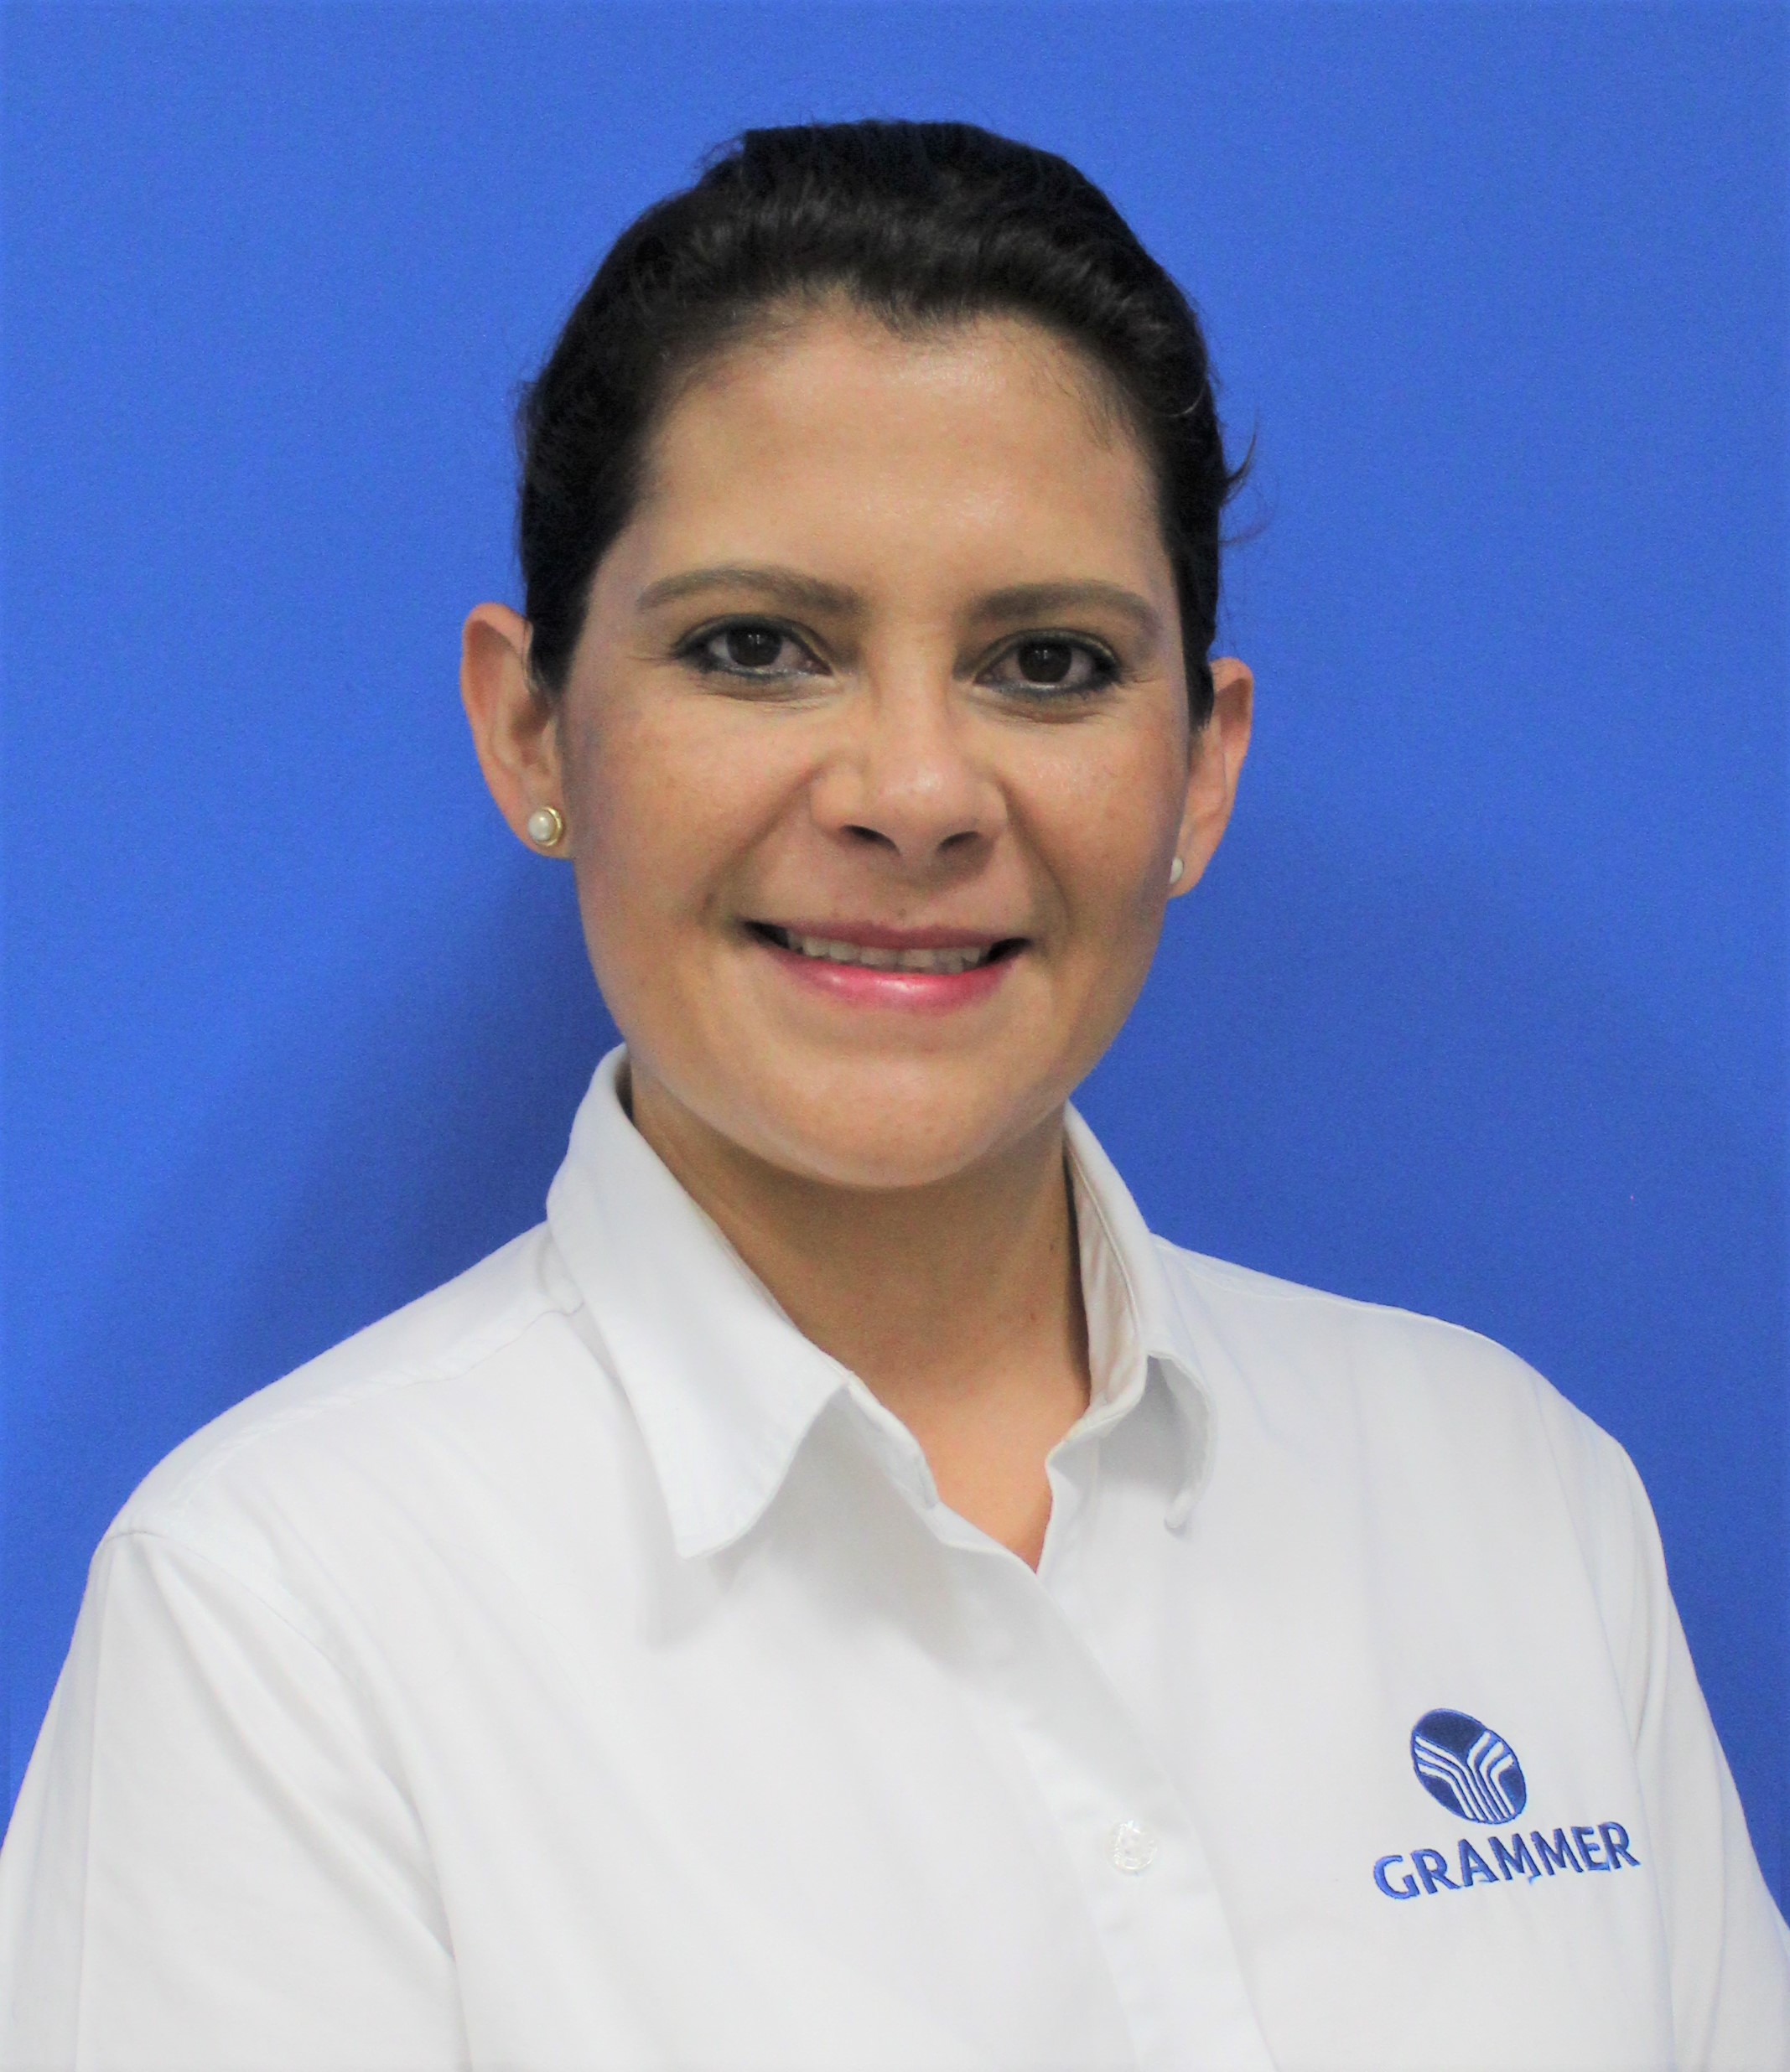
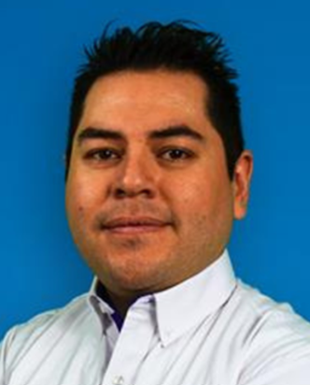
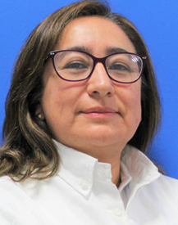
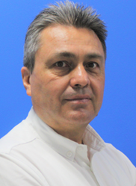

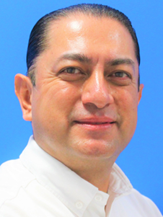
Organization Chart Management 2025
Luis Olvera
Qro. Plant Manager
Yulissa Trejo
Ricardo Hernandez
Jose Espejel
SH&E Coordinator
GPS Coordinator
IT Responsible
Jezlia Martinez
Alberto Fiscal
Liliana Sistos
Manuel Arriaga
Margarita Gomez
Edmundo Sanchez
Fernando Guzman
Rhoman Mota
HR Manager
Quality Manager
Enginering Manager
Plant Controller
Logistic Manager
Maintenance Manager
APU Manager
APU Manager
 | 2025
WC | 12
Open Position | 0

Slide 4
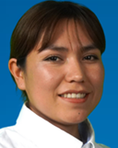
Organization Chart SH&E 2025
SH&E
Coordinator
Yulissa Trejo
Juana Bustamante
Health & Safety
Analyst
 | 2025
WC | 2
Open Position | 0

Slide 5
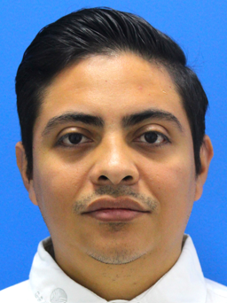
Organization Chart GPS 2025
GPS
Coordinator
Ricardo Hernandez
GPS Engineer
Erik Duran
 | 2025
WC | 1
BCI | 1
Open Position | 0

Slide 6
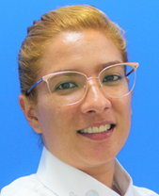
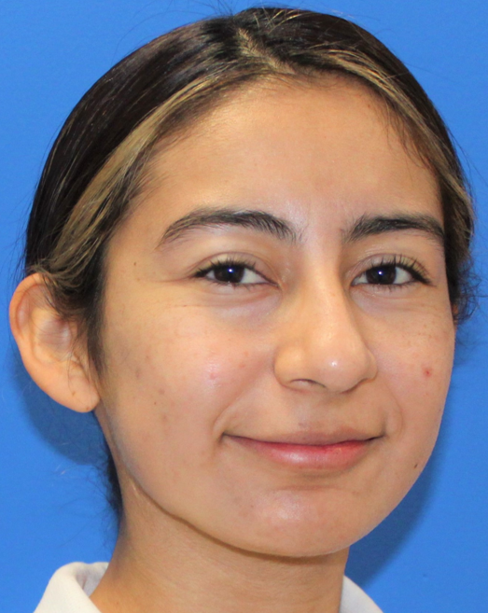
Organization Chart Controlling 2025
Manuel Arriaga
Plant
Controller
Ariadna Muñoz
Mariana Vega
Jr. Plant
Controller
Jr. Plant
Controller
 | 2025
WC | 3
Open Position | 0

Slide 7
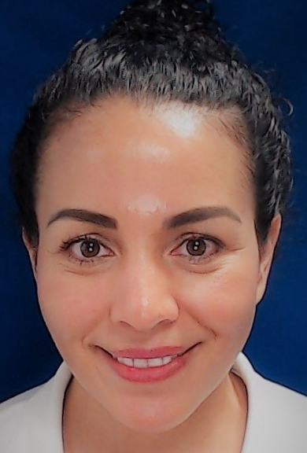
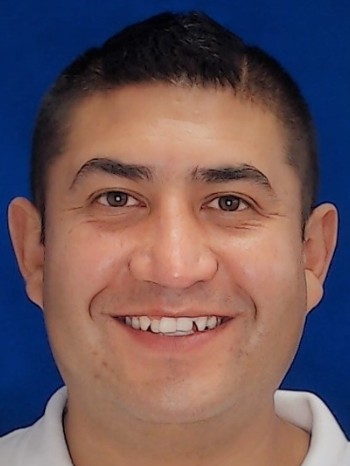
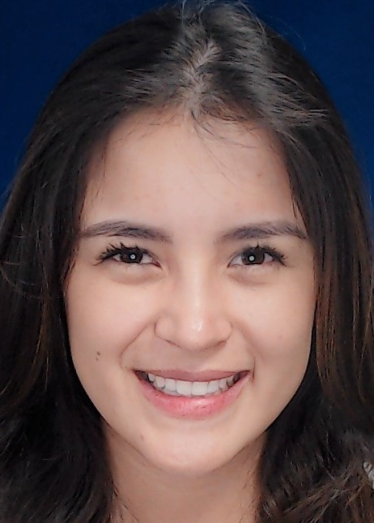
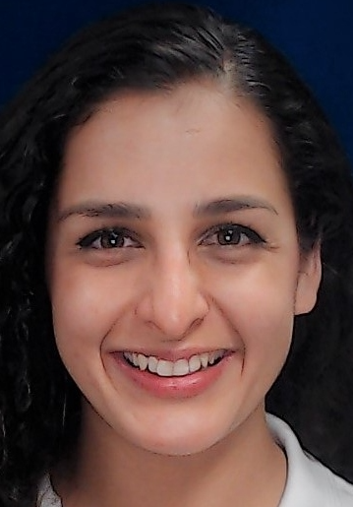
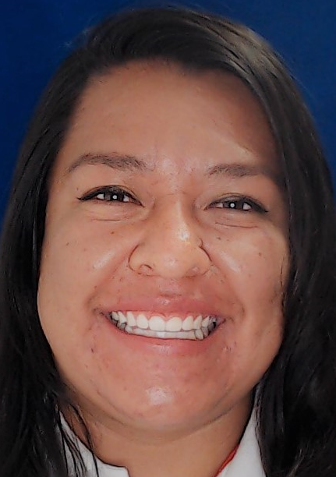
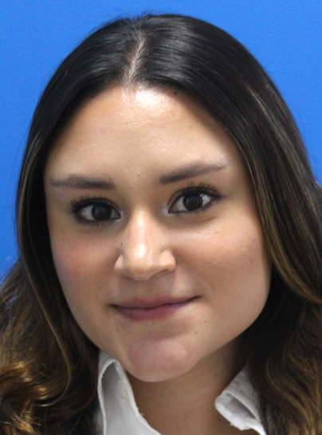
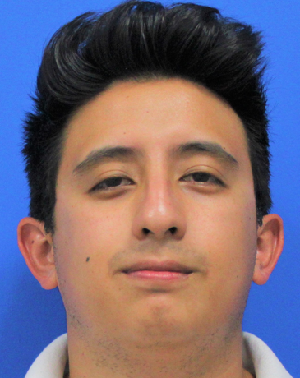
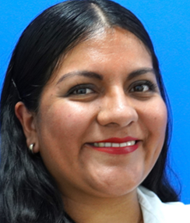
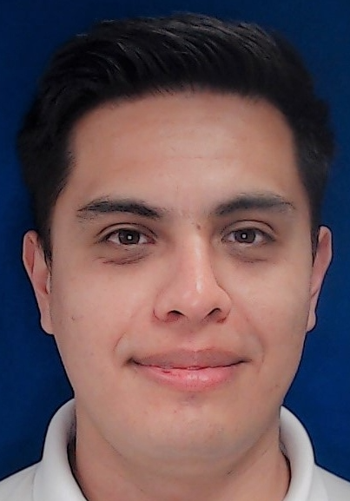
Organization Chart Human Resources 2025
HR
Manager
Jezlia Martinez
Perla Martinez
Yomara Soto
Jonathan Cañizo
Training
Coordinator
Payroll
Coordinator
Labor Relations &
R&S Coordinator
Paola Noguez
Comunication &
OD Coordinator
Payroll Analyst
Recruiting Analyst
Comunication Analyst
Trainner
Janete Ibarra
Roberto Arreola
Renata Diaz
Miguel Ángel Solorio (BCI)
Viridiana Zarraga (BCI)
 | 2025
WC | 8
BCI | 2
Open Position | 0

Slide 8
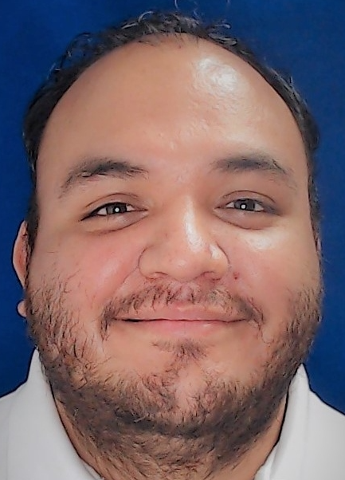
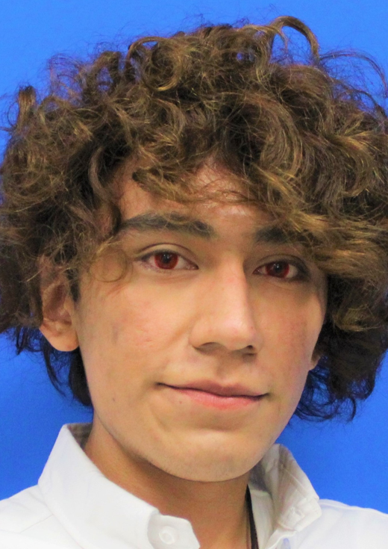
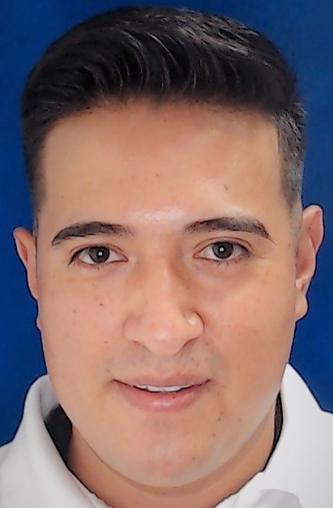
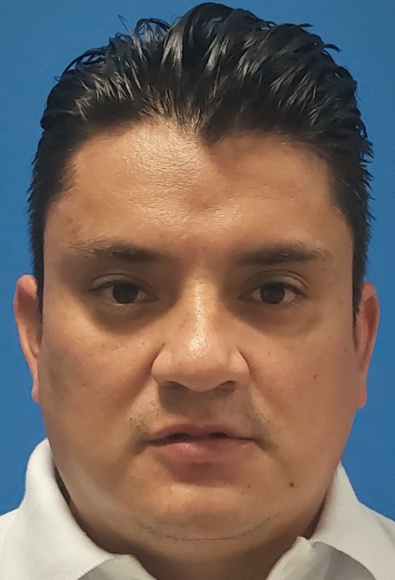
Organization Chart I.T. 2025
IT
Responsible
Jose Espejel
Gerardo Ortiz
Hadbet Altamirano
Software
Developer
Software
Developer
IT Technician
Cesar Mendoza
Cristopher Martinez
 | 2025
WC | 2
BCI | 2
Open Position | 0

Slide 9
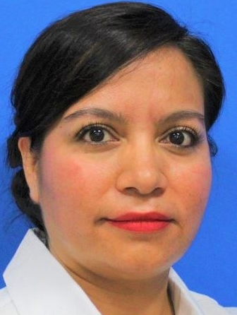
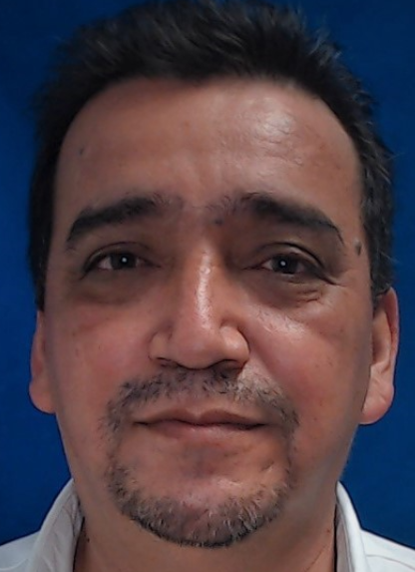
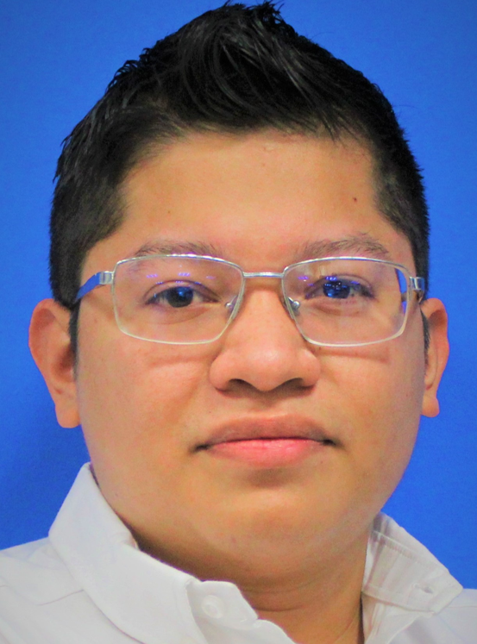
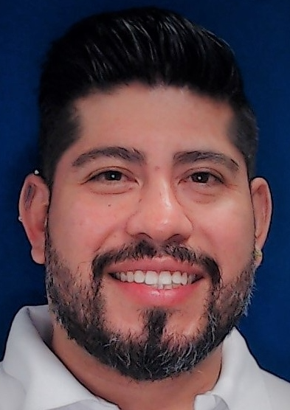
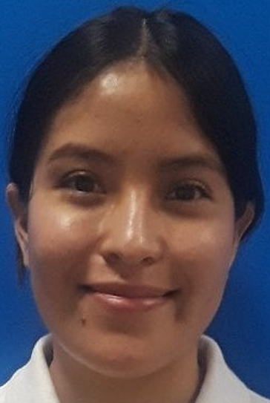
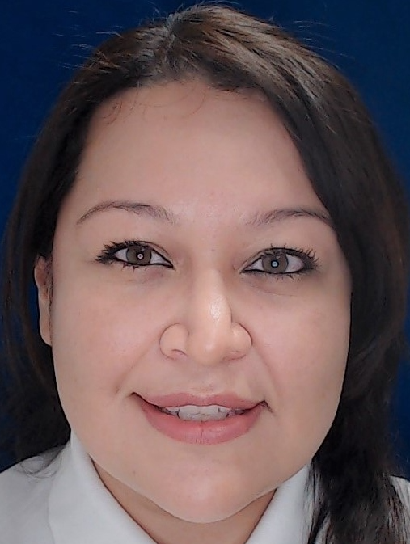

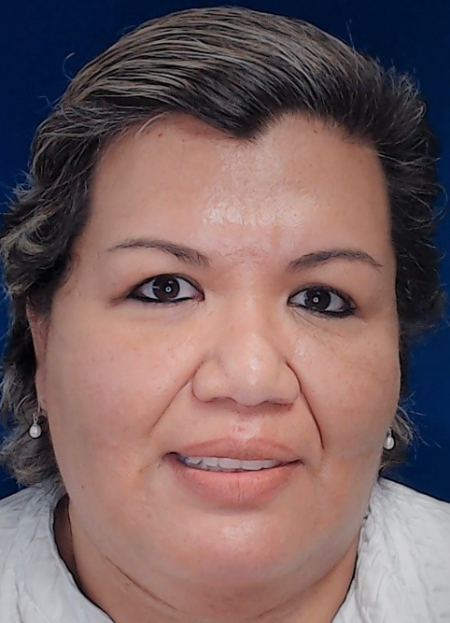
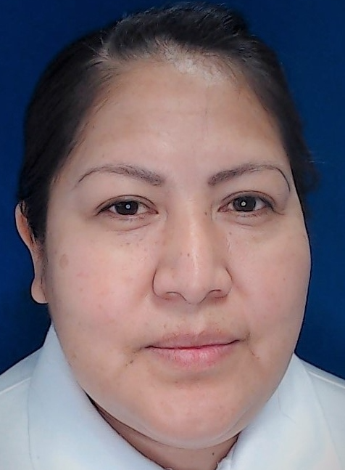
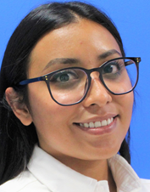
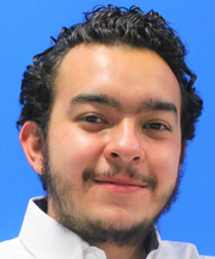
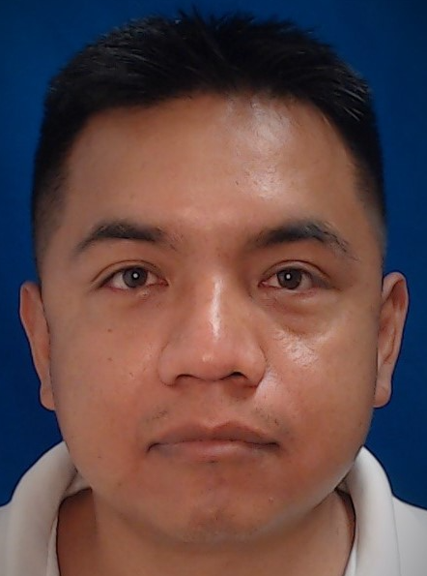
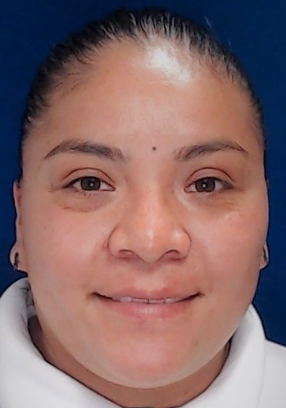
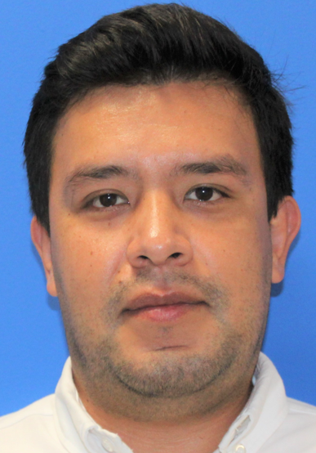
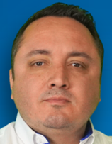
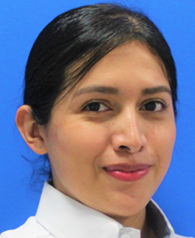
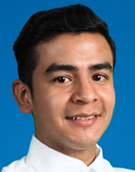
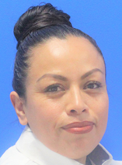
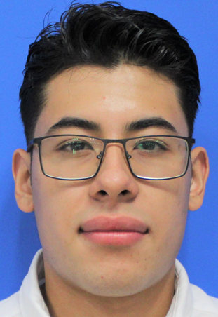
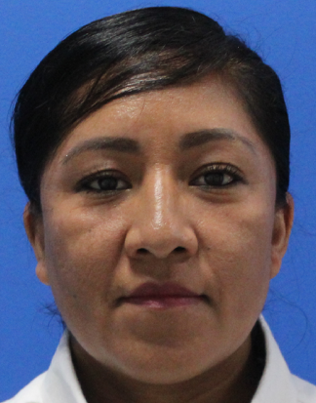
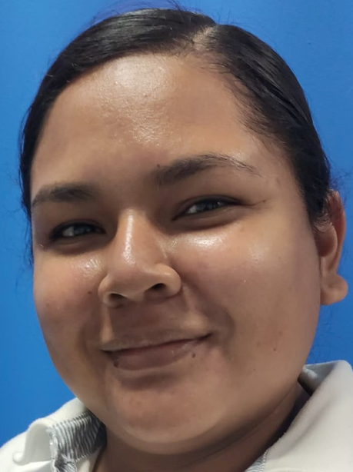
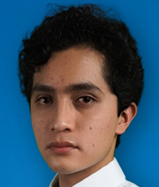
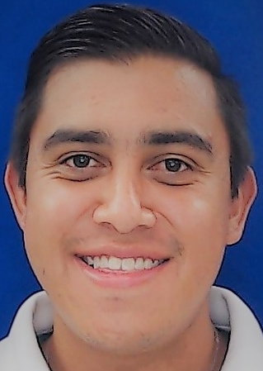



Organization Chart Quality 2025
Alberto Fiscal
Quality
Manager
Daniela Candelas
Oscar Gomez
Quality
Coordinator
SQA, Incoming &
Laboratory Coordinator
Fabian Medina
Hector Varela
Quality System
Coordinator
Quality
Coordinator
Quality Planner P0
Quality Planner P1
Quality Planner P0
SQA
Metrology
Product Process Auditor / Customer service
Yunuen de Jesus Molina
V A C A N C Y
Ana Laura Garduño (BCI)
Karen Angeles
Juan Pablo Ugalde
Jessica Trejo
Juan Anselmo Cuevas
Luis Manuel Andrade (BCI)
Carmen Lomeli
Javier Gonzalez
Alonso Correa (BCI)
Mireya Hernandez
Leyda Trejo
Luis Adrian Aragon (BCI
Shoenstatt Almanza
Quality Technician / Auditor
Incoming
Elba Montiel
Jesus David Romero
Maria Lucia Chavero
Jason Zúñiga
Miguel Ángel Toto
Araida Ramirez
Miixtli Castillo
 | 2025
WC | 14
BCI | 13
Open Position | 1

Slide 10


























Organization Chart Engineering 2025
Liliana Sistos
Engineering
Manager
Fernando Martinez
New Prooject Industrialitation &
Advanced Manufacturing Coordinator
Diana Mendoza
Julian Rojas
Automotive New Prooject Industrialitation
Jose Maria Martinez
Vanessa Garcia
Engineering Change
Coordinator
Process Engineer
Coordinator
Process Engineer
Coordinator
Process Engineer
Process Engineer
Engineering Change
Manufacturing Design Engineer
Project Engineer
Oscar Zuppa
Raul Sanchez
Isabel Meza
Roberto Carlos Perez
Enrique Aguirre
Jesus Aragon
Mauri Frias
Luis Francisco Muro
Heriberto Olvera
Alejandra Guzman (BCI)
Alondra Angeles
Diego Alberto Vizcarra
David Garcia
Marco Antonio Barragan
Edgar Yair Ruiz
Mario Alberto Suarez
Control & Automation Enginner
Mario Martinez
Isaac Aparicio
 | 2025
WC | 23
BCI | 1
Open Position | 0

Slide 11






















Organization Chart Logistics 2025
Logistic
Manager
Margarita Gomez
Miguel Vega
Alma Elena Bautista
Jair Ruiz
Christian Leon
Fabiola Ordoñez
Mariela Valdez
Customer Service
Coordinator
Traffic
Coordinator
Warehouse
Coordinator
SAP
Super User
Series Material Planner
Coordinator
Pre-Series
Coordinator
Gerardo Rodriguez
Production Control
Coordinator
Material Planner
Logistic Planner
Production Control ARM
Customer Service
Edgar Duque
Claudia Trejo
Karla Erika Sanchez
Luis Roberto Espinosa (BCI)
Fernanda Leon
Mario Ivan Hernandez
Jovany Ramirez
Zuriel Arteaga
Fernanda Montalvo
Leslie Alvarez
Illia Magdaleno
German Nieto
Jose Luis Garcia
Production Control HR
Luis Miguel Arreguin
Production Control HR
Julio Montoya
 | 2025
WC | 20
BCI | 3
Open Position | 0

Slide 12





























Organization Chart Warehouse 2025
Jair Ruiz
Warehouse
Coordinator
Fatima Lopez
Warehouse
Leader
Engadi Gonzalez
Jose Cesáreo Guerrero
Cycle count
Leader
Line feeding
Leader
Shipping
Warehouse Leader
Manuel Cruz
Jair Rojas
Gary Ortiz
Maria del Carmen Ríos
Incomming
Warehouse Leader
Line feeding
Leader
Line feeding
Leader
Cycle Count
Incomming Warehouse
Capturista Aduana
Line feeding Warehouse
Line feeding Warehouse
Gilberto Lugo
Salinas De Jesus Rosalva
Moreno Beatriz Andrea
Ramon Nájera
Jesus Gonzalez
Jose Luis Martinez
Luis Alberto Martinez
Jose Luis Moctezuma
Jaime Pilar
Juana Yadira Hernandez
Wendy Estrella Suarez
Santiago Hernandez Juan Manuel
Córdoba Resendiz Edgar
Mendoza Castro Manrique
Martinez Rivera Juan Jose
Silva Garcia Luis Fernando
Contreras Ibarra Francisco Martin
Sanchez Moya Jose Mariano
Alfredo Pantoja
Rafael Ramirez
Quintana Flores Javier
Ventura Perez Juan Carlos
Rodriguez Martinez Luis Javier
Hernandez Soria Abraham Israel
Cruz Corpus Raymundo
Aguilar Garcia Ricardo
Figueroa Leal Juana
Garcia Rodriguez Liliana
V A C A N T E
Maria Gloria Garcia
Omar Estrada
Arteaga Rosas Maria Del Carmen
Espino Aguas Sandra
Vega Moreno Ivan
Sanchez Carrillo Horacio
Alzati Castillo Salvador
Moreno Silva Rafael
Riaño De La Luz Timoteo
Gante Rubio Karla Pueblito
Perez Monge Clemens Janith
Farias Olguin Emmanuel
Arroyo Sanchez Carlos Raymundo
Velazquez Silva Axel
Sanchez Olmedo Michetl
Ocampo Cortez Paul Ismael
Gaytán Camarillo Daniel
Sanguino Alarcón Juan Carlos
Eduardo Aguilar
Shipping Warehouse
Shipping Warehouse
Luis Armando Aguilar
Eduardo Nava
Marco Martinez
Giovani Salazar
Guillermo Ramos
Adán Navarrete
Miguel Ángel Moreno
Mario Acevedo
Juan Antonio Delgado
Ramiro Hernandez
Miguel Navarrete
Leonardo Aguillón
Norberto Rodriguez
 | 2025
BCI | 68
BCD | 0
Open Position | 1

Slide 13






























Organization Chart Maintenance 2025
Edmundo Sifuentes
Maintenance
Manager
Jonathan Ayala
Maintenance
Coordinator
Alejandro Martinez
Aaron Rodriguez
MRO
Coordinator
Maintenance
Coordinator
Maintenance Planner
Diana Laura Salinas
Mold Engineer
Injection / Foam Technician
Sewing Technician
Assembly Technician
Toolcrip Warehouse
Facilities Engineer
Hector Hernandez
Marco Posadas (TL)
Aldo Ángel Perez
Ivan Gregorio
Alan Orlando Ramos
Luis Hernandez
Jose Bautista
Ángel Lara
Miguel ángel Alba
Nabor Damián (TL)
Luis Eduardo Reséndiz
Juan Manuel Negrete
Jose Manuel de la Luz
Emmanuel Godoy
Mold Technician (Foam)
Facilities Technician
Raul Guerrero
Margarito Morales
Mold Auxiliary (Foam)
Sewing Technician
Sewing Technician
Beatriz Bárcenas
Oswaldo Moreno
Assembly Technician
Mario Martinez Flores
Leonel Mendoza
Jesus Gonzalez (TL)
V A C A N T E
Mold Technician (Injection)
Isac Moreno
Cutting Technician
Tooling Technician
Miguel Mendoza
Abraham Hernandez
Luis Enrique Reyes
 | 2025
WC | 3
BCI | 28
BCD | 0
Open Position | 1
Mold Auxiliary (Injection)
Manuel Gutierrez

Slide 14











Organization Chart APU: 1 BMW / DAIMLER 2025
Rhoman Mota
APU
Manager
Monica Aguila
Brayan Granados
Production
Supervisor
Production
Supervisor
Shift Leader
Shift Leader
Luis Ángel Navarro
Jose Antonio Garcia
Pamela Gomez
Arleth Garcia
Julia Jasso
Benjamin Luna
Noemi Salinas
Alejandra Martinez
David Solano
 | 2025
WC | 3
BCI | 9
Open Position | 0

Slide 15

























Organization Chart APU2: Primary Processes, Armrest, Consoles & Metals 2025
Fernando Guzman
APU
Manager
Alberto Ordoñez
Production
Supervisor
Uziel Landa
Production
Supervisor
Abigail Ortega
Production
Supervisor
Shift Leader
Setter / Injection molding
Setter / Foam & Insitu
Shift Leader
Setter / Metal & Consolas
Shift Leader
Rosendo Santos
Marcela Dorantes
Ernesto Martinez
Citlali del Roció
Sandra Martinez
V A C A N C Y
Cristóbal Gámez
Miguel Ángel Garcia
Heliodoro Lopez
Antonio Estrada
Daniel Aboytes
Ricardo Alvarez
Jorge Perez
Abner de Jesus Aparicio
Yaquelin Arteaga
Monserrat Juárez
Roberto Medellín
Jose German Garcia
Juan Miguel
Rodrigo Félix
Fausto Cabrera
Jorge Alfredo Brito
Leonardo Castillo
 | 2025
WC | 4
BCI | 22
Open Position | 1

Slide 16


















Organization Chart Regionals 2025
General
Manager
Julio Apaez
Yazmany Villalobos
Team
Assistant
Omar Hernandez
Luis Olvera
Jose Espinosa
Tooling
Engineer
Israel Rivera
Queretaro
Plant Manager
Sales
Engineer
Mario Lobato
Carlos Plazola
Noemi Ramirez
Finance
Manager
Project
Manager
Logistic Regional
Manager
Quality
Engineer
V A C A N C Y
Inj Molding
Engineer
Miriam Larios
Beatriz Huerta
Alfonzo Ranz
Roberto Fuentes
Dulce Mata
Warranty
Engineer
Finance
Manager
Tetla
Plant Manager
Mario Centeno
Project
Manager
Logistic Freight
Specialist
EHS Regional
Manager
Cesar Ramirez
Alicia Garcia
Blanca Vieyra
Project
Manager
Finance
Manager
GPS Regional
Manager
 | 2025
WC QRO | 16
WC TETLA | 2
Open Position | 1

Slide 17





Organization Chart Regionals 2025
Alicia Garcia
Finance
Manager
Daniel Alvarez
General
Accountant
Ivan Ordaz
Accountant
Payable
Myranda Urbina
Alexis Gutierrez
Treasure
Accountant
Receivable
Deneb Carvajal
Accountant
Receivable
 | 2025
WC | 6
Open Position | 0

Slide 18








Organization Chart Regionals 2025
Beatriz Huerta
Finance
Manager
Maria Rodriguez
Accountant
Receivable
Ignacio Urrusquieta
Juan Pablo Garcia
Victor Tlapalamatl
General
Accountant
Accountant
Payable
Customs
Yolanda Gonzalez
Accountant
Payable
Ivan Tecpa
Customs
Laura Xocjhitemotl
Accountant
Payable
Dulce Gutierrez
Accountant
Payable
 | 2025
WC QRO | 2
WC TETLA | 7
Open Position | 0

Slide 19





















Organization Chart Purchasing 2025
Purchasing
Manager
Mandy Guo
Mandy Acting
Fernanda Dorantes
Dorothy Kamiskase
Brian Rossbach
Pedro Borges
NPM Manager
Americas
Operation
Director Commodity
Americas
Sr. Manager Supplier
Quality
Purchasing
Analyst
V A C A N T E
Manuel Cortes
Luis Méndez
Project Manager
Tool Move
Strategic
NPM
Roció Gomez
Commodity
Manager
Commodity
Manager
Isabela Lombera
MX Regional Supplier Development Engineer
Commodity Buyer
Commodity Buyer
NPM Buyer
Operational Buyer MX
Adrián Cortez
Marangely Maldonado
Alexis Urbina
Monica Villanueva
Rocío Cabrera
Noel Prado
Antonio Zarate
Amelia García
Miguel Ángel Castillo
Janett Martínez
Marlene Quezada
Karen Fonrouge
Vanessa Cruz
Alfredo Encinas
MX Regional Supplier Development Engineer
 | 2025
WC | 21
Open Position | 0

Slide 20

Contact
Hernandez, Ricardo
Phone: +52 442 186 0189
E-mail: Ricardo.hernandez@grammer.com

